Slide 1
Crime Data Analysis in Tamil Nadu (2014–2022)
Submitted by Munusamy M
DATE : 26-06-2025

Slide 2
Objective of This Analysis
Analyze trends in crime across Tamil Nadu from 2014 to 2022
Identify key crime categories and emerging patterns
Provide data-driven insights and control suggestions
Focus on policy-level and socio-political implications

Slide 3
Data Sources Used
National Crime Records Bureau (NCRB) Reports: 2014–2022
Tamil Nadu Police website
Tool used: Microsoft Power BI & Excel

Slide 4
Classification of Crime Categories
Category | Includes
Violent Crimes | Murder, Kidnapping & Abduction
Tech/Economic Crimes | Cybercrime, Economic Offences
Vulnerable Group Crimes | Women, Children, SC, ST
Foreign-Related | Crimes by/against foreigners

Slide 5
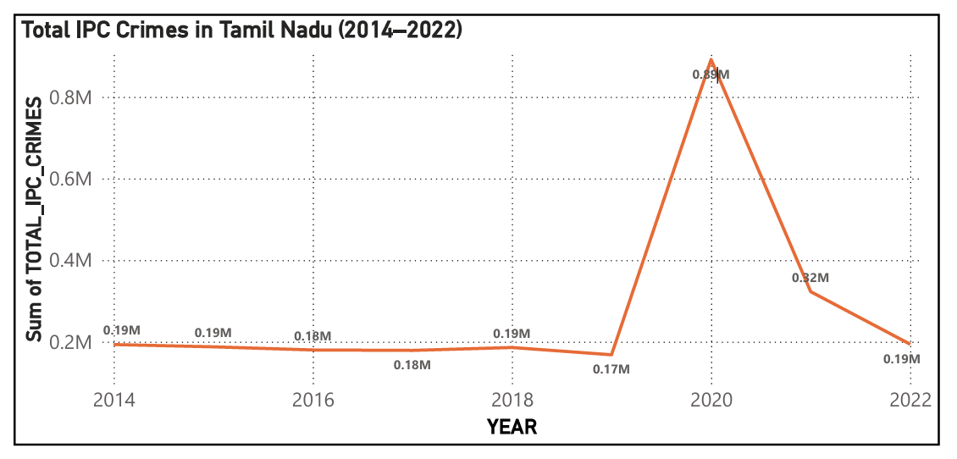
Total IPC Crimes (2014–2022)
Total crimes declined from 1.93L to ~1.7L — a steady drop.

Slide 6
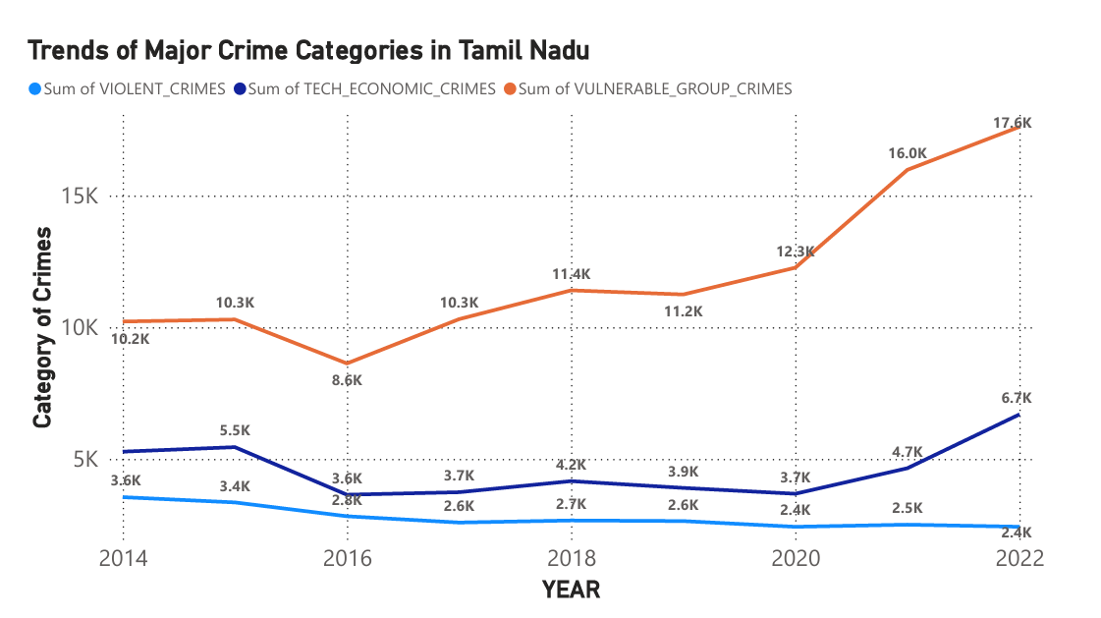
Trends by Category (2014–2022)
Cyber & vulnerable group crimes rose; violent crimes declined.

Slide 7
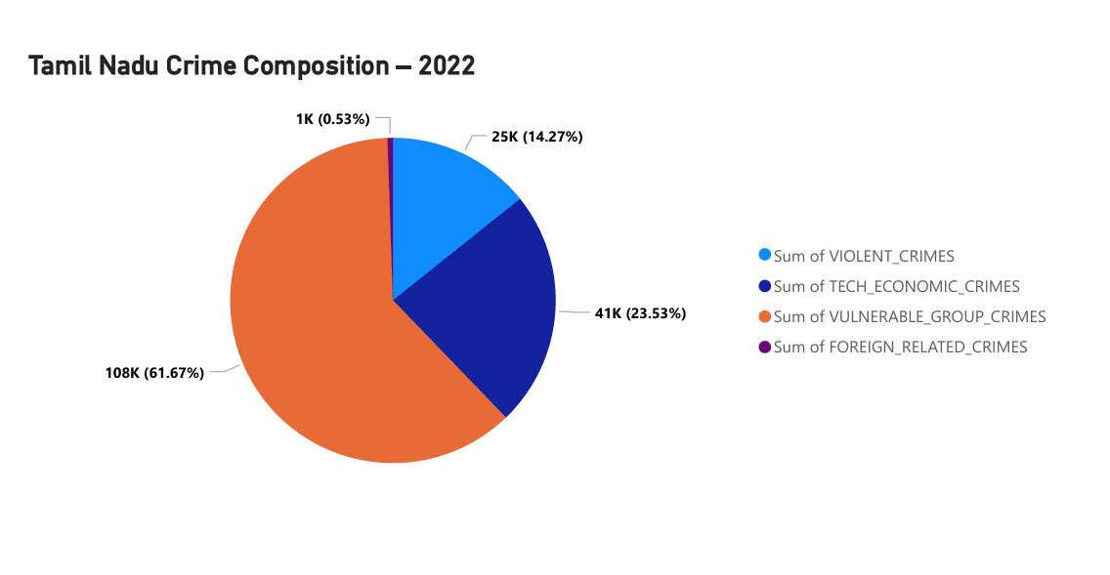
Crime Composition – 2022
Vulnerable groups make up the highest share of reported crimes.

Slide 8
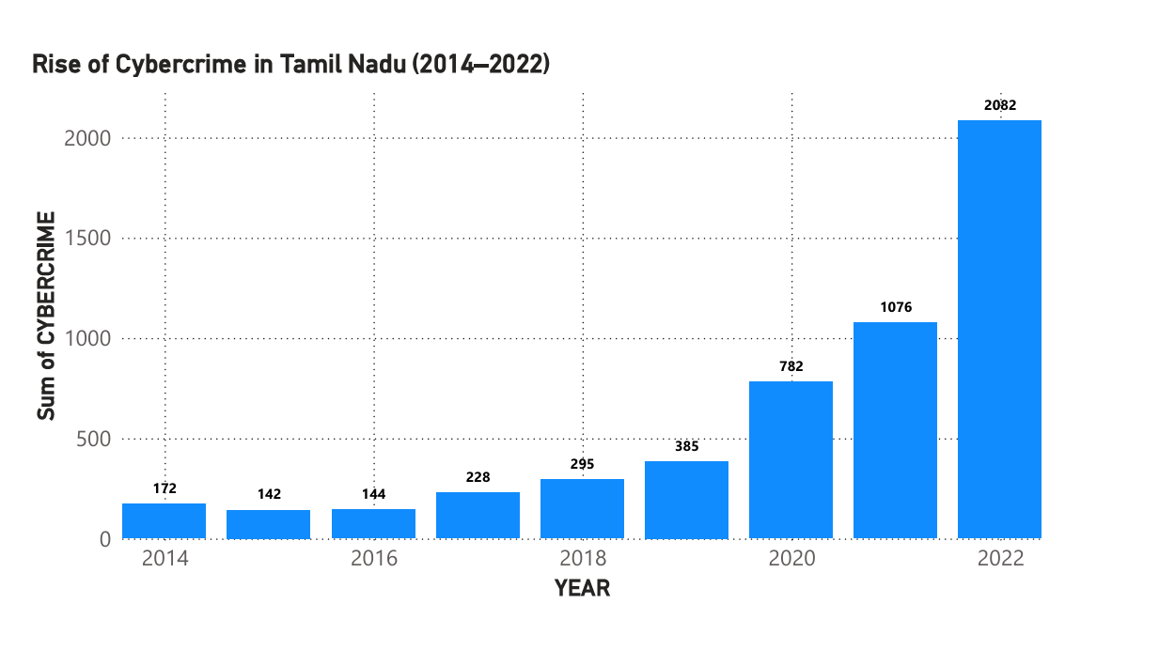
Rise of Cybercrime in Tamil Nadu
Cybercrime increased over 70% since 2014 — urgent digital law enforcement needed.

Slide 9
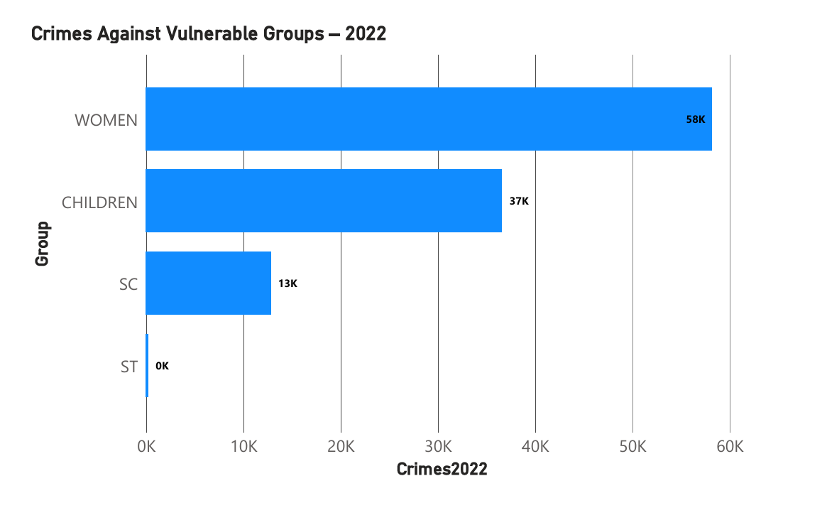
Vulnerable Groups (2022)
Crimes against children and women dominate this segment.

Slide 10
Data-Driven Insights
Overall crime falling, but tech & social crimes rising
Cybercrime is the fastest-growing category
Women and children remain at risk
Crime patterns suggest urban vs rural differences
Foreign-related crimes still low, but growing

Slide 11
Recommendations & Control Strategies
Expand cybercrime units and citizen awareness
Women & child protection hotlines and community training
AI/ML-based district-level crime prediction
Policy attention to SC/ST crime hotspots
Introduce predictive policing dashboards for TN Govt

Slide 12
Thank You

